Slide 1
Object Oriented Programming CS F213 Amit Dua
Slide material from book “Head First Design Patterns”

Slide 2
Singleton Pattern

Slide 3
One object only.. throughout
The idea is to generate only one object for the class throughout the entire run of software.
e.g. registry settings, logging, device drivers’ object
Otherwise:
incorrect program behavior,
overuse of resources, or
inconsistent results.

Slide 4
Its your turn now
How to restrict only one object creation?
Solutions ??

Slide 5
Global variable
??
-at the start on the program, the object is created.
No matter when we need that.

Slide 6
Lets build the solution.
new MyObject();
Private constructor()
MyClass.getInstance();
Use the static method to create and return only one object

Slide 7
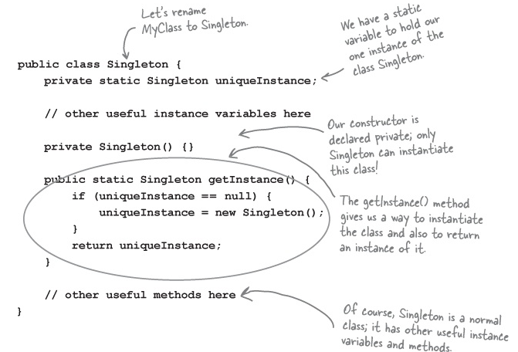

Slide 8
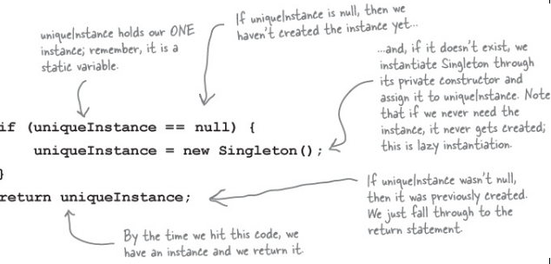
Looking deeply

Slide 9
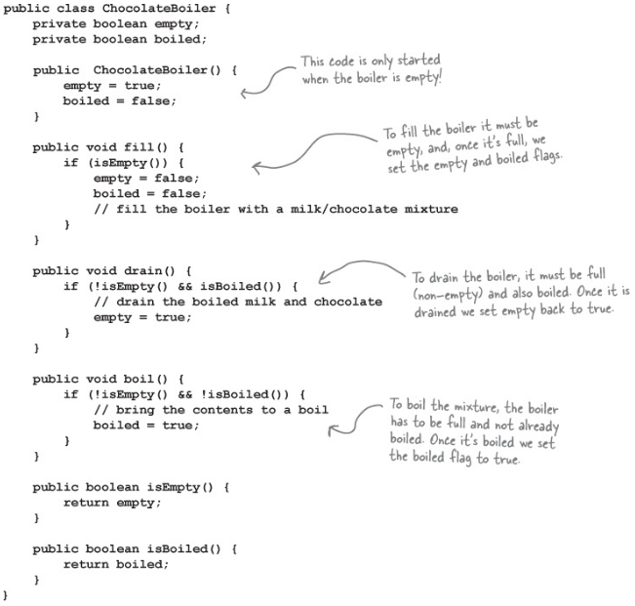
We need only one instance/object of this class.
Why??

Slide 10
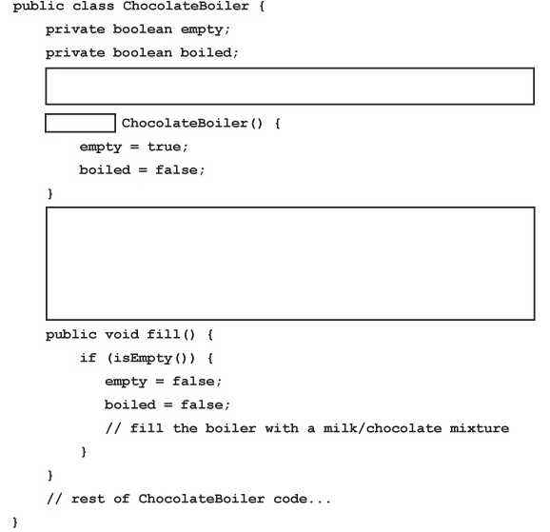
Its your turn now.

Slide 11
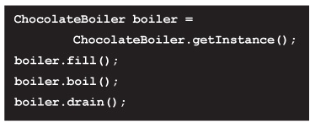
Still problem
To optimize the performance I used 2 threads
Spill over resulted in 1000L of chocolate wasted?
What went wrong??

Slide 12
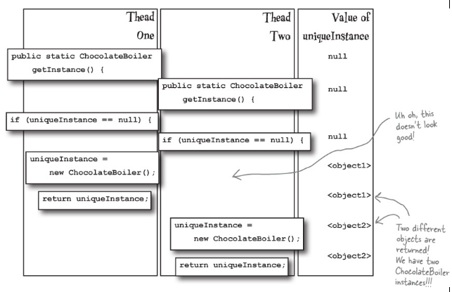
Possible execution of threads

Slide 13
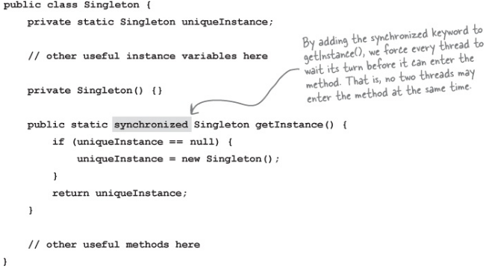
Synchronized
Both visibility and
atomicity

Slide 14
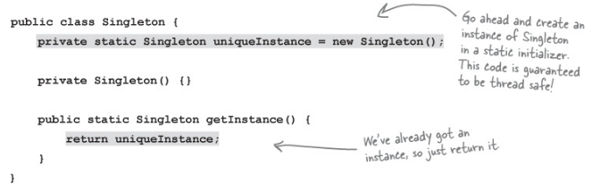
Use eager instantiation:

Slide 15
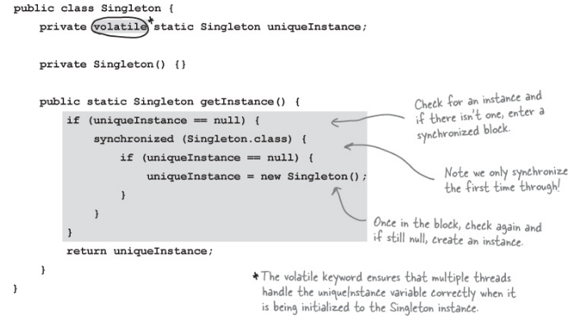
Use “double-checked locking” to reduce the use of synchronization in getInstance().
Visibility
Not atomicity

Slide 16
Pros and cons of ..
Use eager instantiation:
Double-checked locking:
Synchronize the getInstance() method:

Slide 17
Which principle is violated
Amongst SOLID design principles?
One Class, One Responsibility

Slide 18
Summarize
The Singleton Pattern ensures a class has only one instance, and provides a global point of access to it.
One instance –private constructor, static method
Global point of access –static reference and method

Slide 19
QUES?

Slide 20
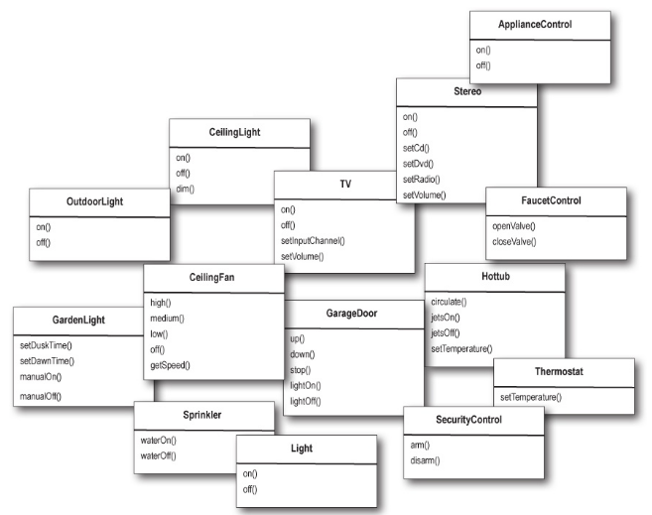

Slide 21
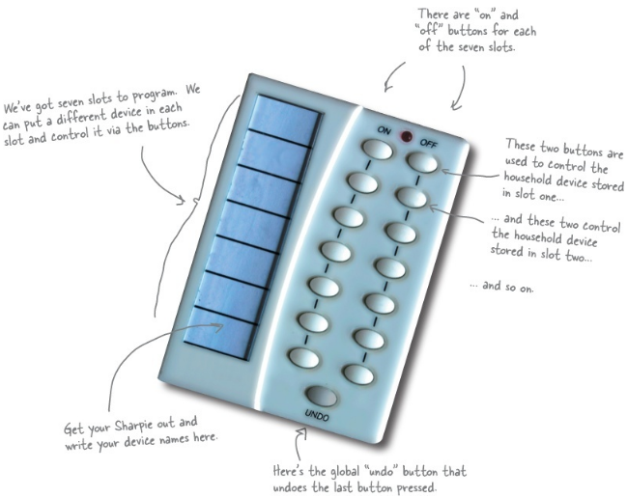

Slide 22
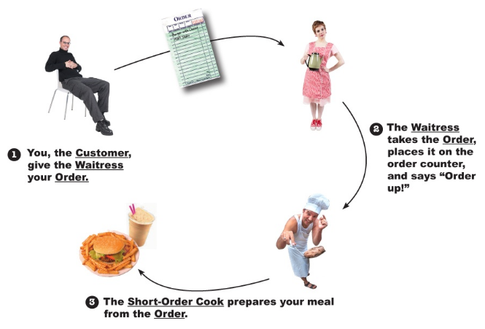
Restaurant analogy

Slide 23
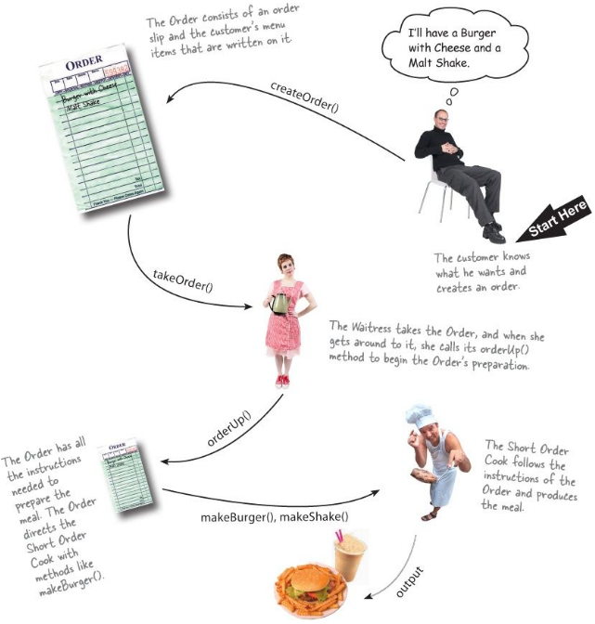

Slide 24
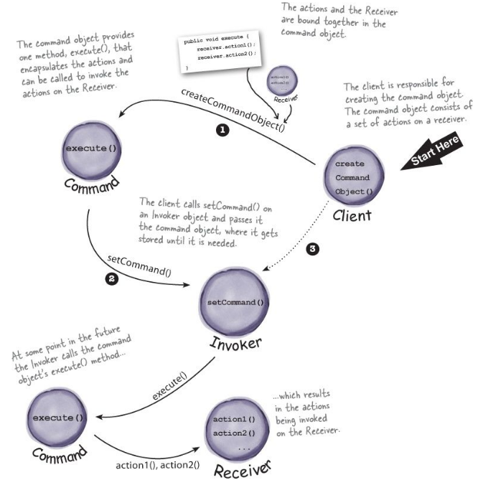

Slide 25

Command interface

Slide 26
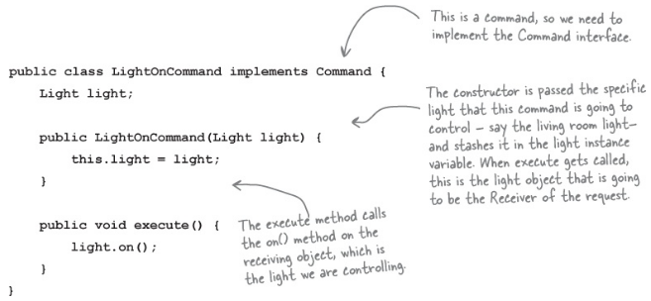
Implementing a command to turn a light on

Slide 27
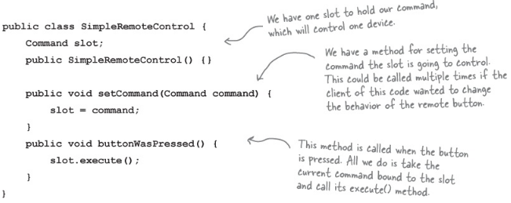
Using the command object

Slide 28
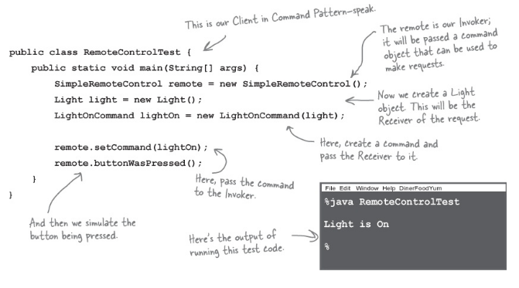
Creating a simple test to use the Remote Control

Slide 29
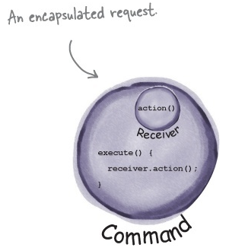
command object encapsulates a request by binding together a set of actions on a specific receiver

Slide 30
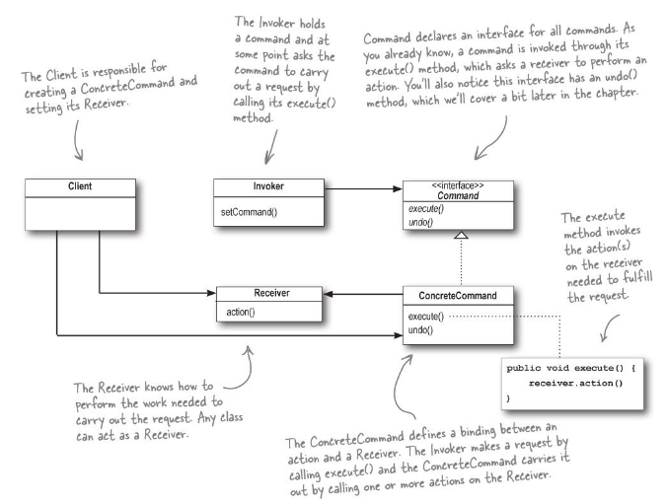
Command pattern

